Slide 1
Python
By
Amrita Helwade

Slide 2
Introduction to Python
Python is a general purpose programming language that is often applied in scripting roles.
So, Python is programming language as well as scripting language.
Python is also called as Interpreted language
Python is widely used in Artificial Intelligence, Machine Learning, Neural Networks and other advanced fields of Computer Science.
Python had deep focus on code readability.

Slide 3
History
Invented in the Netherlands, early 90s by Guido van Rossum
Python was conceived in the late 1980s and its implementation was started in December 1989
Guido Van Rossum is fan of ‘Monty Python’s Flying Circus’, this is a famous TV show in Netherlands
Named after Monty Python
Open sourced from the beginning

Slide 4
Scope of the Python
- Bioinformatics System Administration -Unix -Web logic -Web sphere -Web Application Development -CGI -Python – Servlets

Slide 5
What can I do in Python
System programming Graphical User Interface Programming Internet Scripting Component Integration Advance Analytics Model Building Artificial Intelligence Machine Learning

Slide 6
It's powerful
Dynamic typing
Built-in types and tools
Library utilities
Third party utilities (e.g. Numeric, NumPy, SciPy)-
Automatic memory management
It's portable
Python runs virtually on every major platform used today

Slide 7
Python Basics
Python Programs
Python programs and modules are written as text files with traditionally a .py extension
Each Python module has its own discrete namespace §Name space within a Python module is a global one.
§Python modules and programs are differentiated only by the way they are called o .py files executed directly are programs (often referred to as scripts)
.py files referenced via the import statement are modules
Thus, the same .py file can be a program/script, or a module This feature is often used to provide regression tests for modules oWhen module is executed as a program, the regression test is executed

Slide 8
Rules for variable declaration
A Python identifier is a name used to identify a variable, function, class, module or other object.
An identifier starts with a letter A to Z or a to z or an underscore (_).

Slide 9
keywords
and | exec | not
assert | finally | or
break | for | pass
class | from | print
continue | global | raise
def | if | return
del | import | try
elif | in | while
else | is | with
except | lambda | yield

Slide 10
Rules for writing code
Python provides no braces to indicate blocks of code for class and function definitions or flow control. Blocks of code are denoted by line indentation.
Correct
if True: print ("True" ) else: print ("False“)

Slide 11
Python accepts single ('), double (") and triple (''' or """) quotes to denote string literals

Slide 12
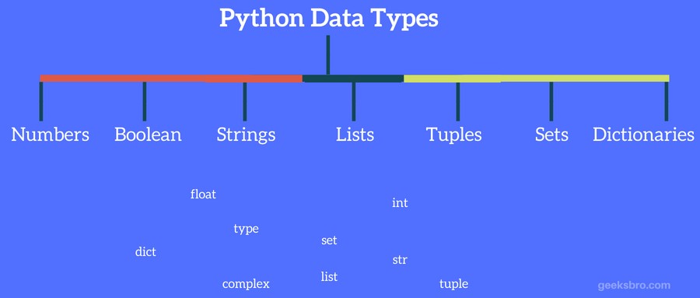
Data Types

Slide 13
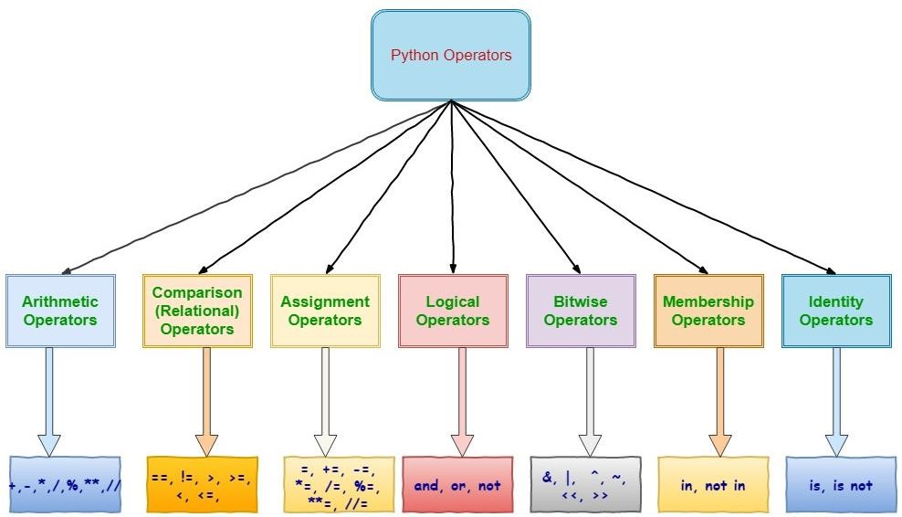

Slide 14
Arithmatic Operator
Operator | Description | Example
+ Addition | Adds values on either side of the operator. | a + b = 30
- Subtraction | Subtracts right hand operand from left hand operand. | a – b = -10
* Multiplication | Multiplies values on either side of the operator | a * b = 200
/ Division | Divides left hand operand by right hand operand | b / a = 2
% Modulus | Divides left hand operand by right hand operand and returns remainder | b % a = 0
// | Floor Division | 9//2 = 4 and 9.0//2.0 = 4.0, -11//3 = -4, - 11.0//3 = -4.0

Slide 15
Comparison operator
Operator | Description | Example
== | If the values of two operands are equal, then the condition becomes true. | ( a == b) is not true.
!= or <> | If values of two operands are not equal, then condition becomes true. | (a != b) is tru ( a <>b) is true.
> | If the value of left operand is greater than the value of right operand, then condition becomes true. | ( a > b) is not true.
< | If the value of left operand is less than the value of right operand, then condition becomes true. | ( a < b) is true.

Slide 16
Assignment Variables
Operator | Description | Example
= | Assigns values from right side operands to left side operand | c = a + b assigns value of a + b into c
+= Add AND | It adds right operand to the left operand and
 | assign the result to left operand | c += a is equivalent to c = c + a
-= Subtract AND | It subtracts right operand from the left operand
 | and assign the result to left operand | c -= a is equivalent to c = c - a
*= Multiply AND | It multiplies right operand with the left operand
 | and assign the result to left operand | c *= a is equivalent to c = c * a
/= Divide AND | It divides left operand with the right operand
 | and assign the result to left operand | c /= a is equivalent to c = c /a

Slide 17
Logical
Operator | Description | Example
and Logical AND | If both the operands are true then condition becomes true. | ( a and b) is true.
or Logical OR | If any of the two operands are non- zero then condition becomes true. | ( a or b) is true.
not Logical NOT | Used to reverse the logical state of its operand. | Not(a and b) is false.

Slide 18
Membership Operators
Operator | Description | Example
in | Evaluates to true if it finds a
 | variable in the specified sequence and false otherwise. | x in y, here in results in a 1 if x is a member of sequence y.
not in | Evaluates to true if it does not finds a variable in the specified sequence and false otherwise. | x not in y, here not in results in a 1 if x is not a member of sequence y.

Slide 19
Input/ Output
Functions like input() and print() are used for standard input and output operations respectively.

Slide 20
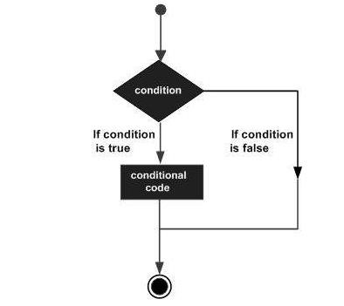
Decision Making

